Slide 1
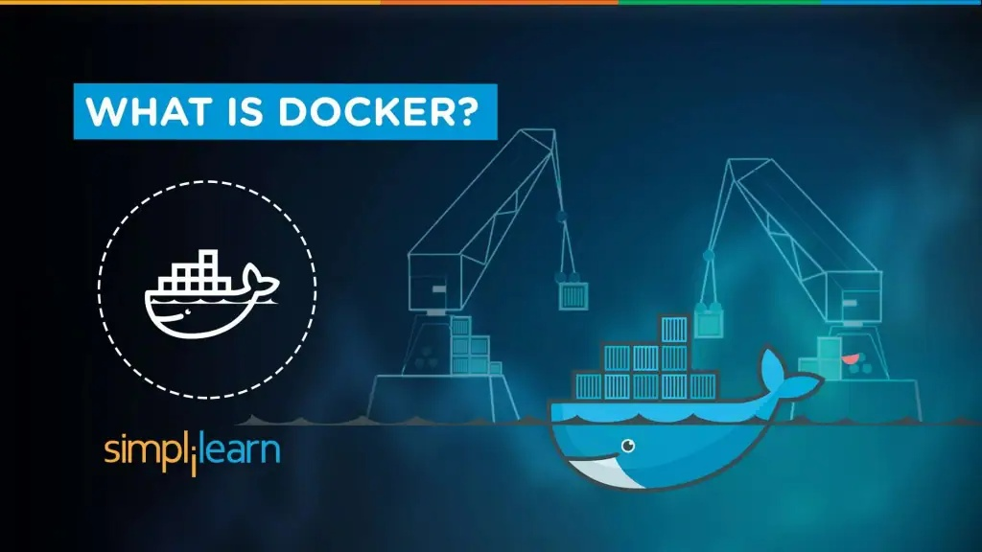

Slide 2
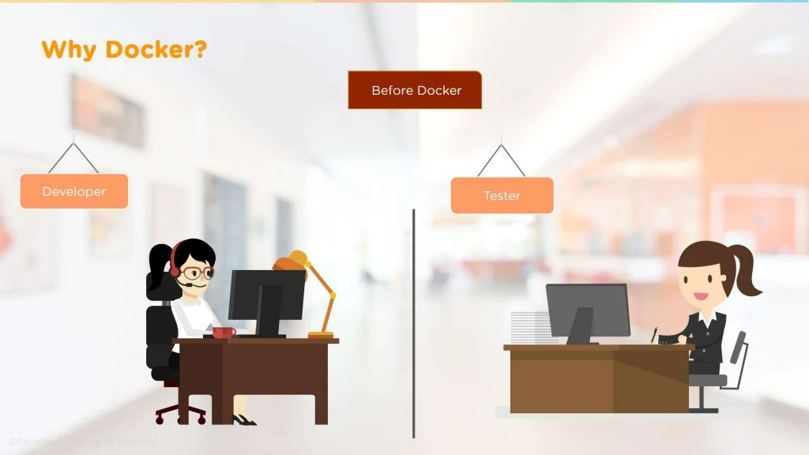

Slide 3
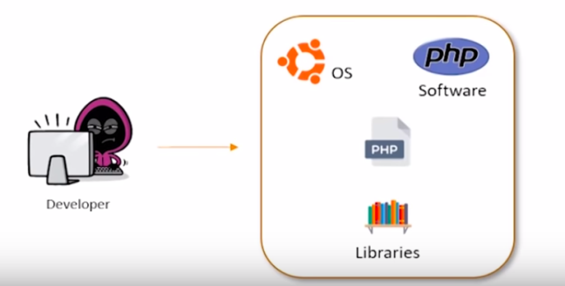
Web application development

Slide 4
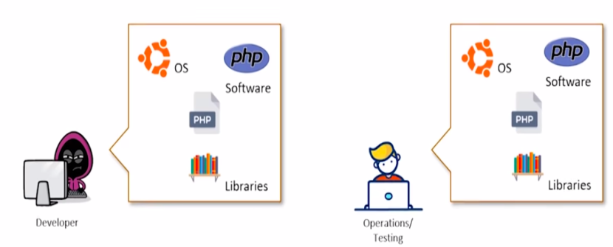
Web application Deployment

Slide 5


Slide 6
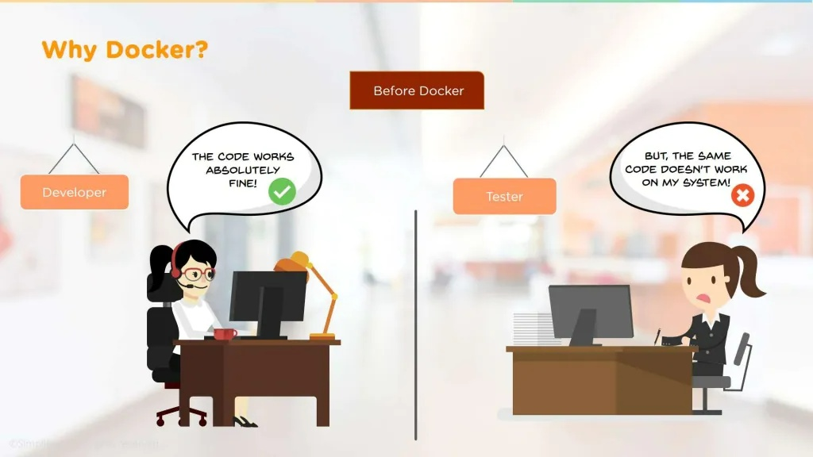

Slide 7
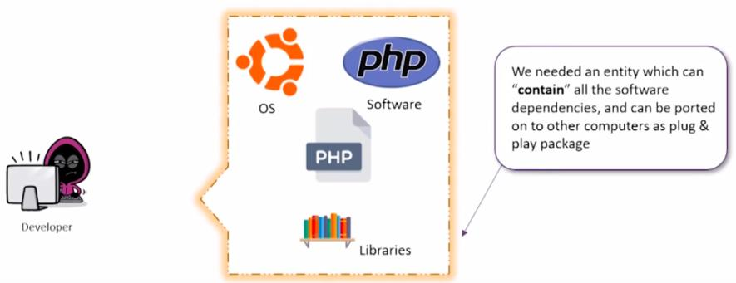
Solution to the Problem ?

Slide 8
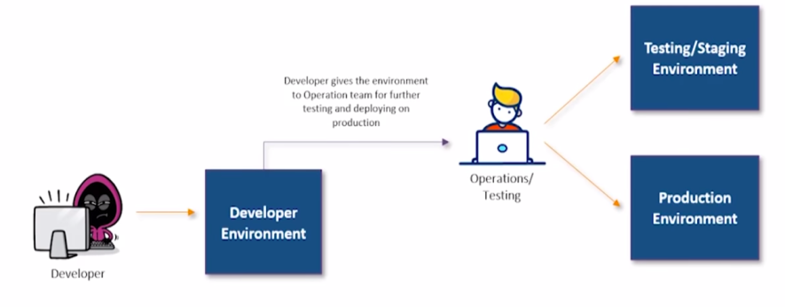
Solution to the Problem ?

Slide 9
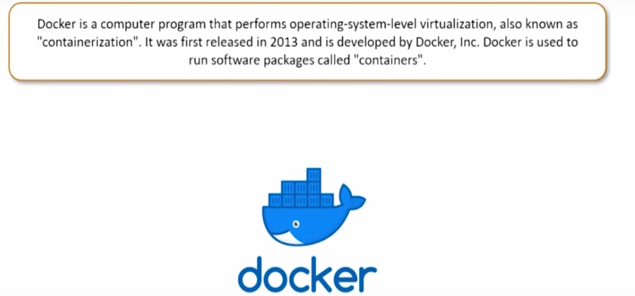
Answer is ?

Slide 10
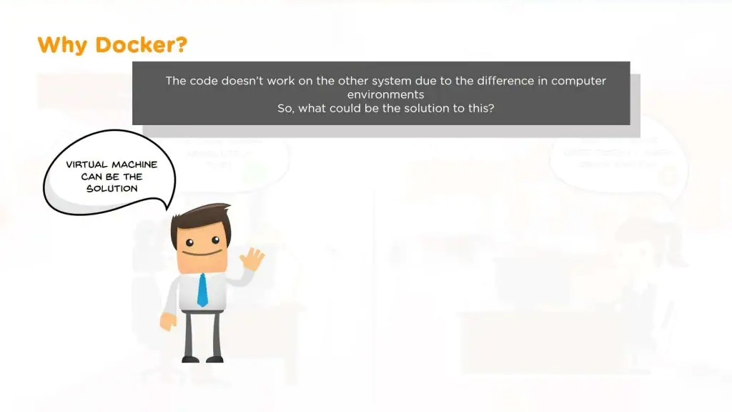

Slide 11
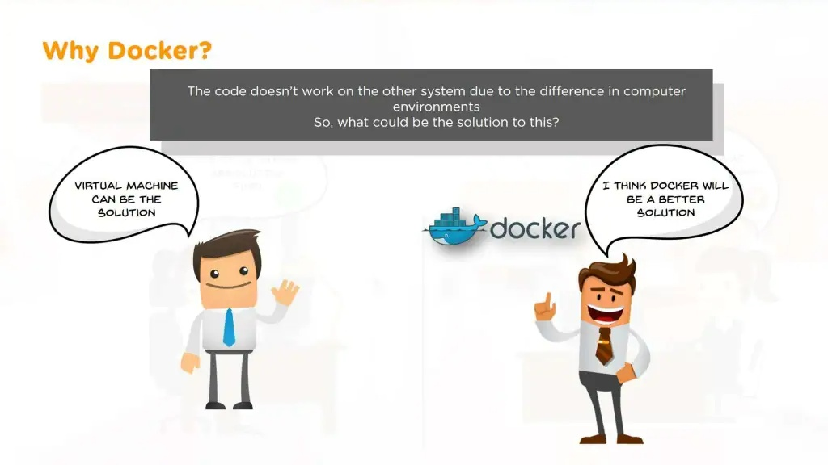

Slide 12
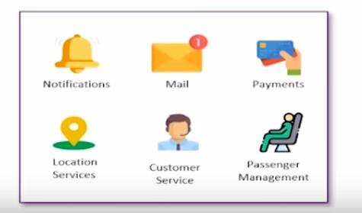
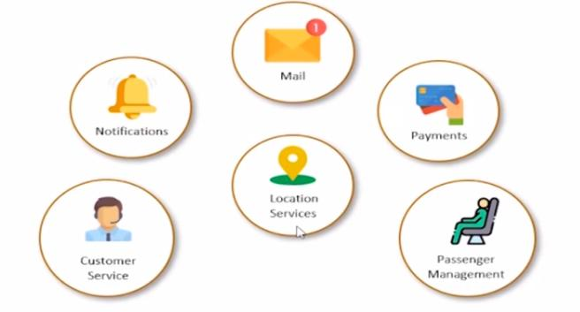
Monolithic Application
Microservice Architecture

Slide 13
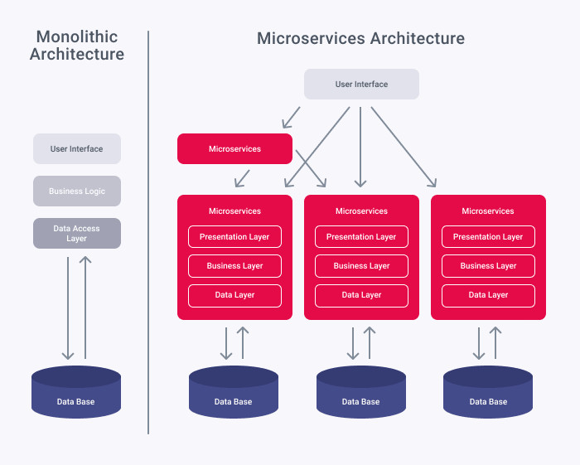

Slide 14
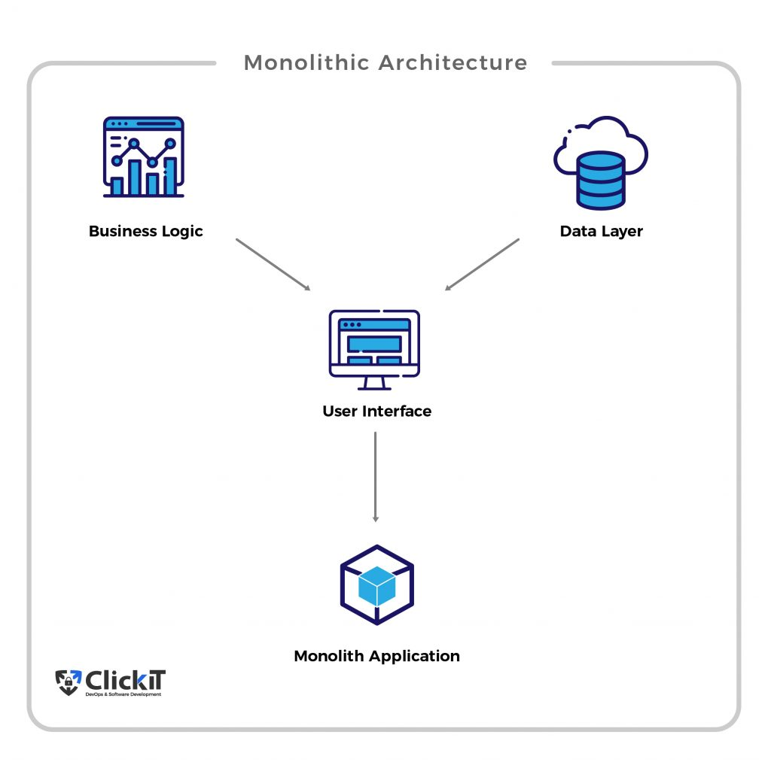
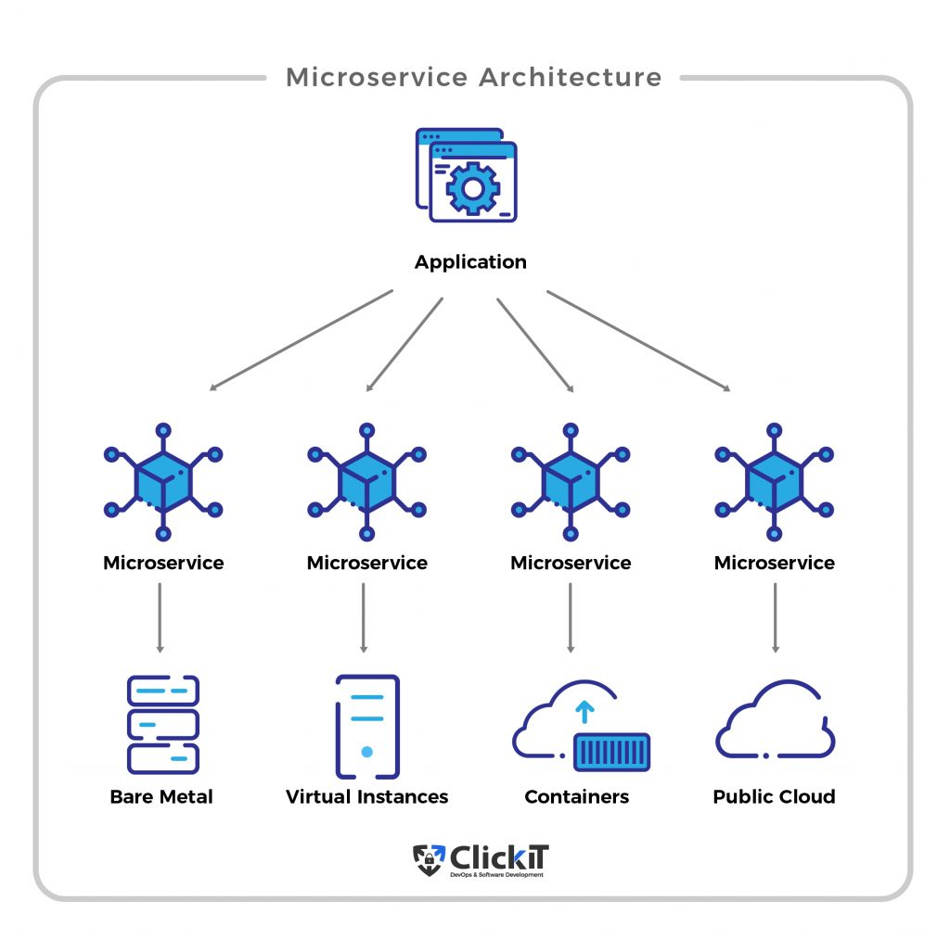

Slide 15
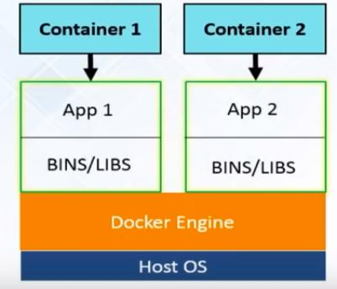
Docker

Slide 16
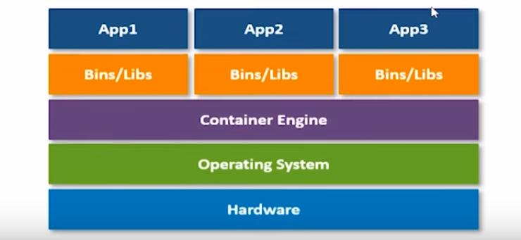
Docker Architecture

Slide 17
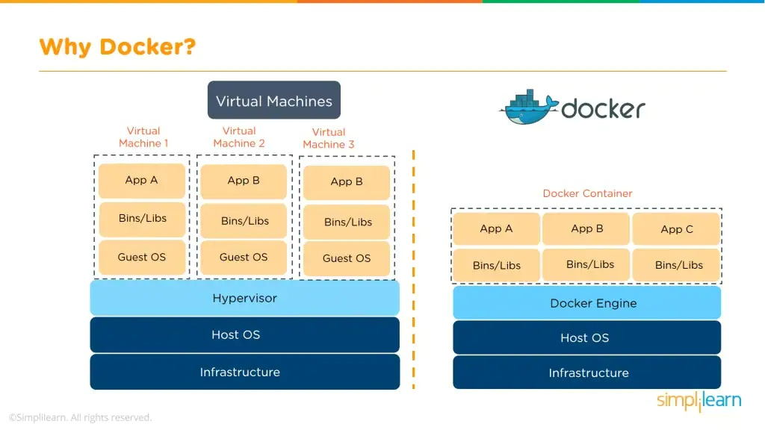
Docker vs Virtual Machine

Slide 18
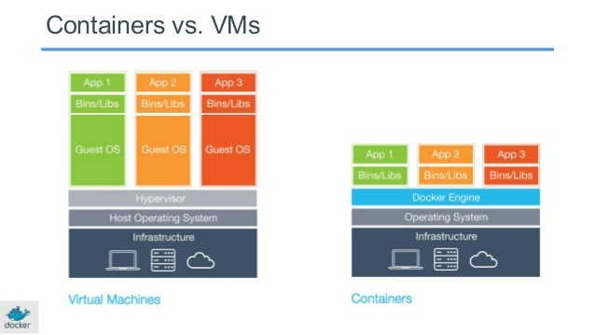

Slide 19
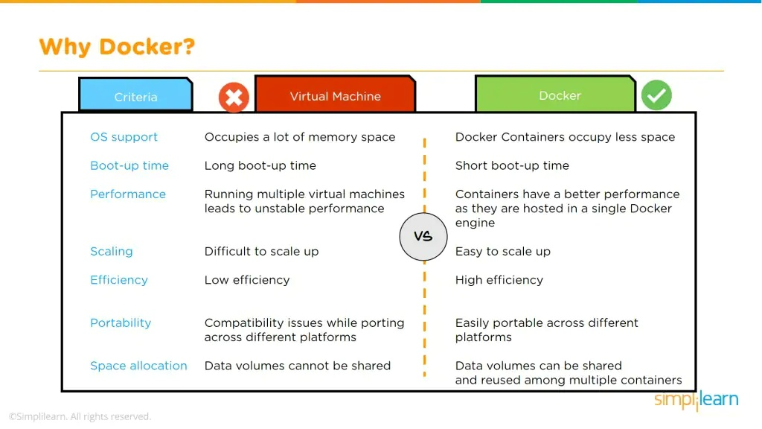

Slide 20
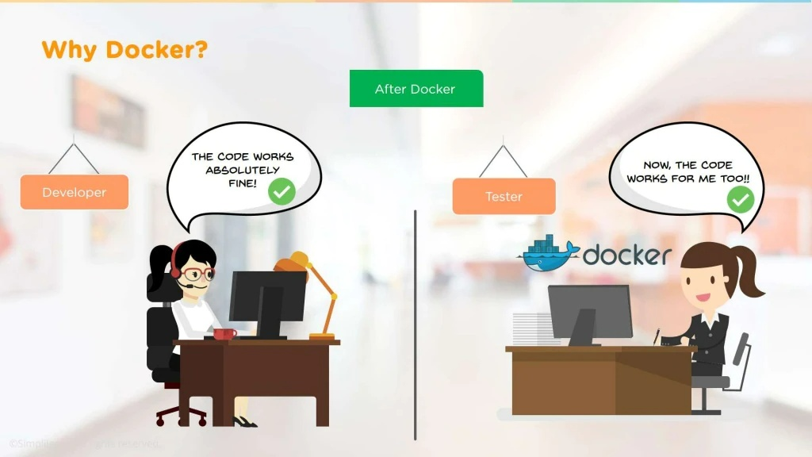

Slide 21
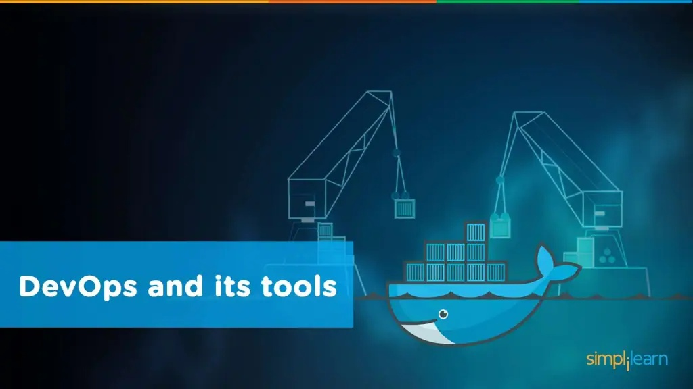

Slide 22
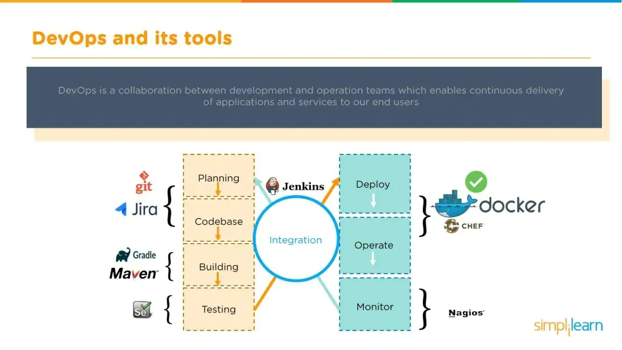

Slide 23
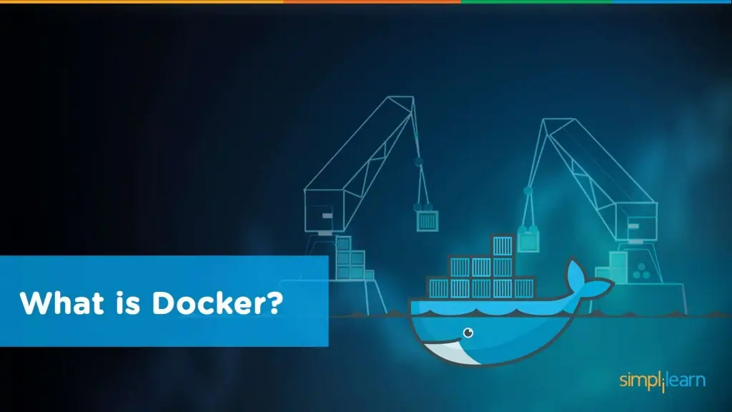

Slide 24
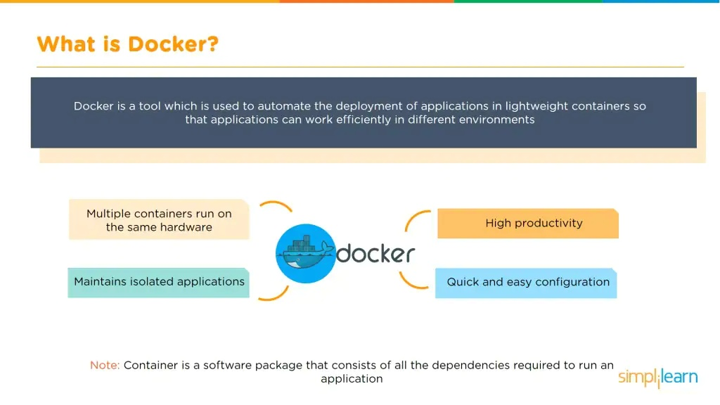

Slide 25
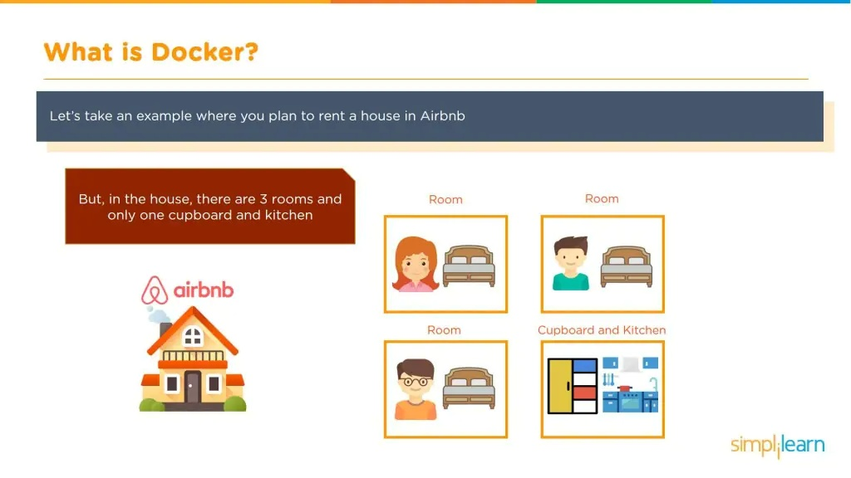

Slide 26
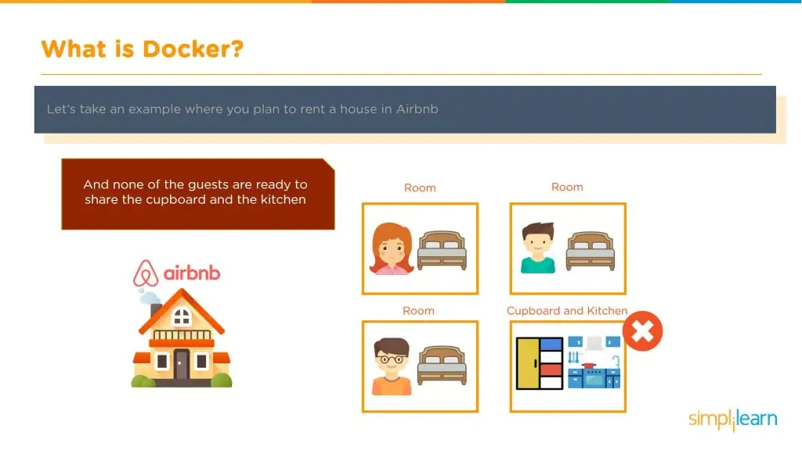

Slide 27
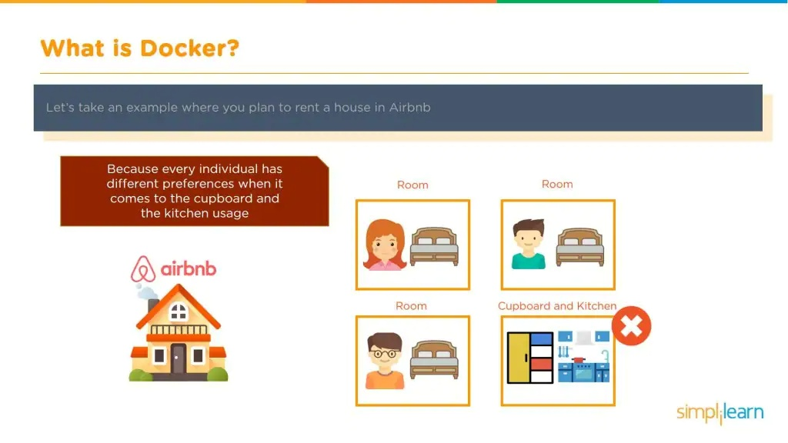

Slide 28
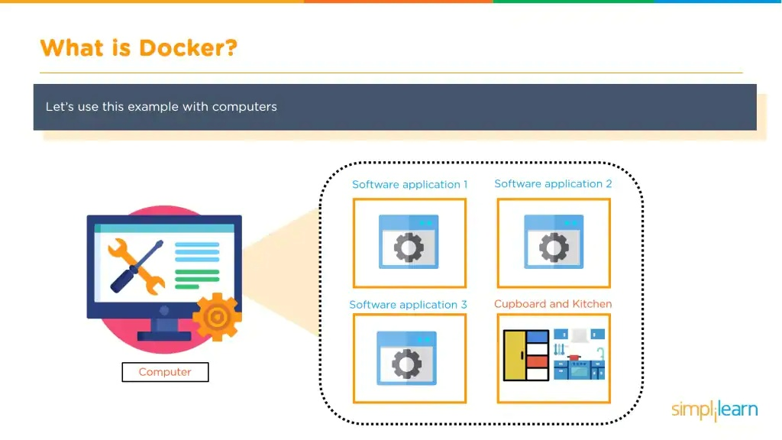

Slide 29
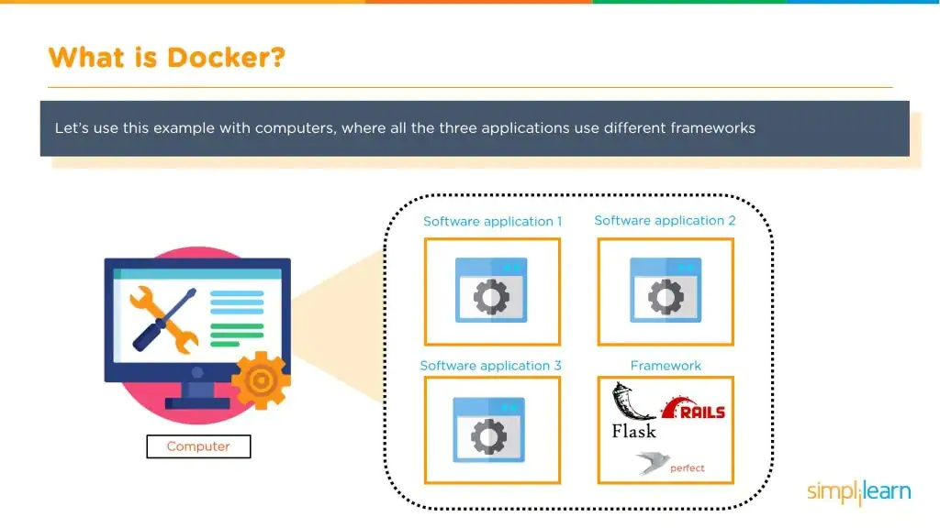

Slide 30
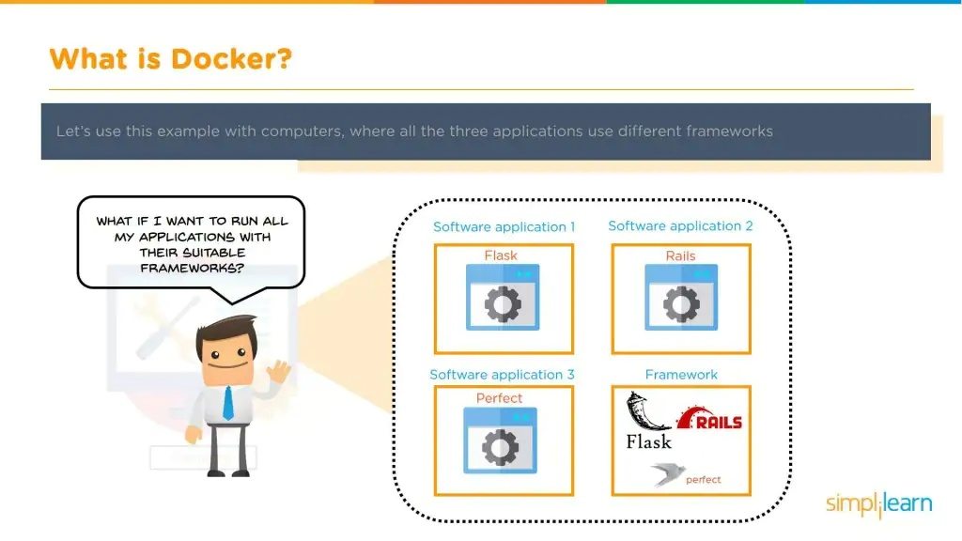

Slide 31
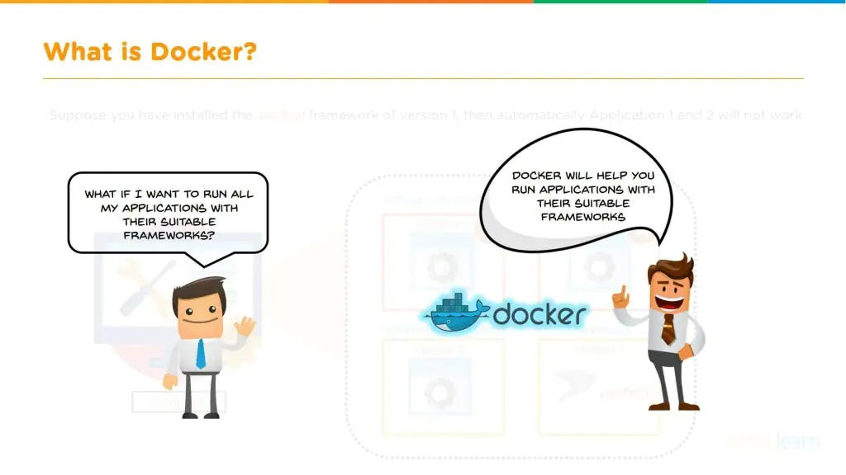

Slide 32
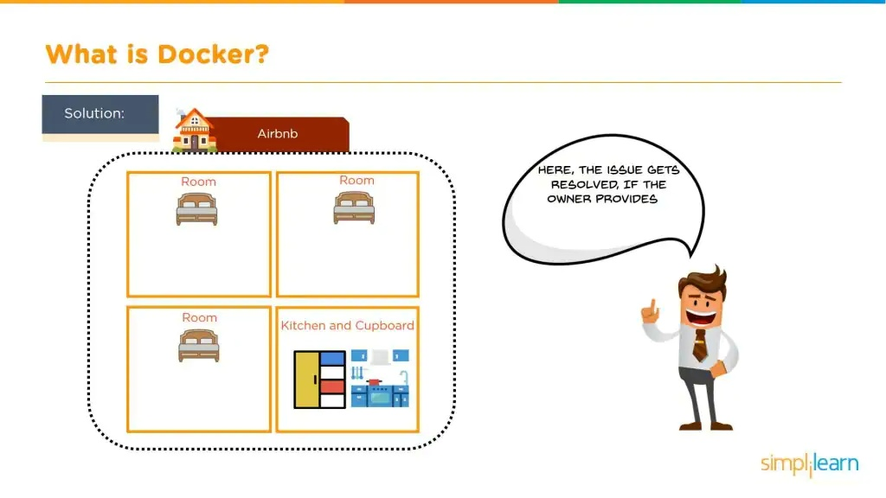

Slide 33
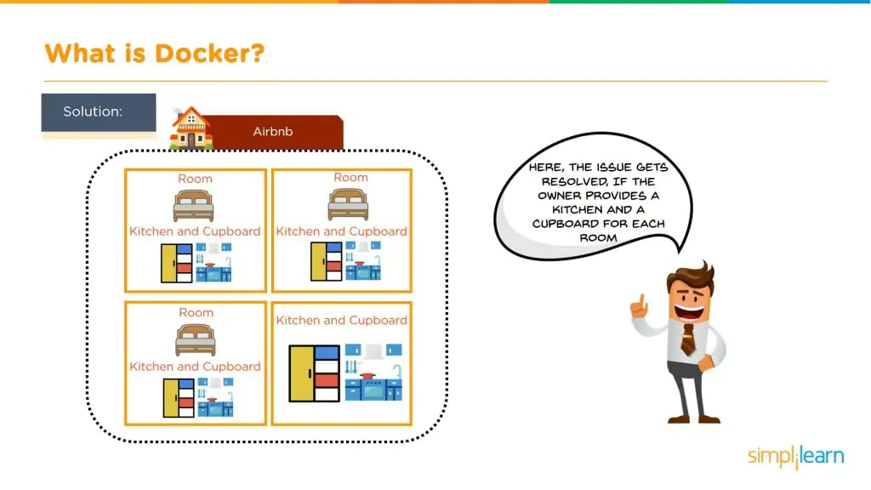

Slide 34
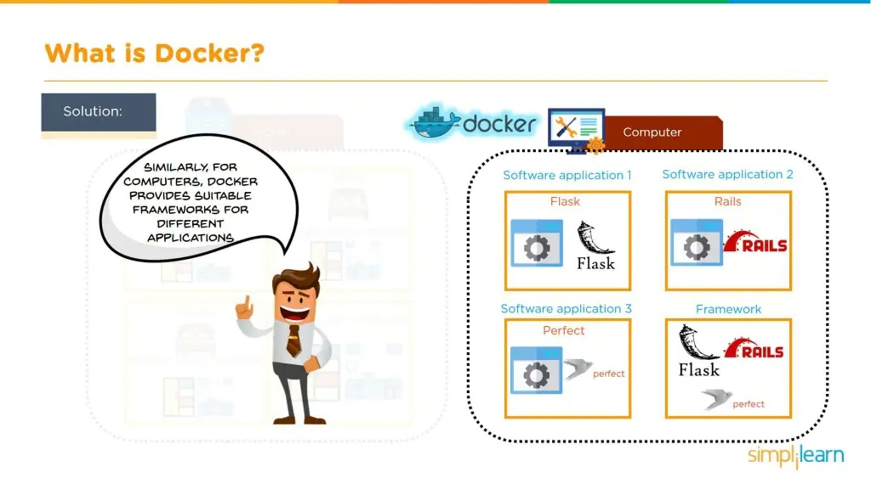

Slide 35
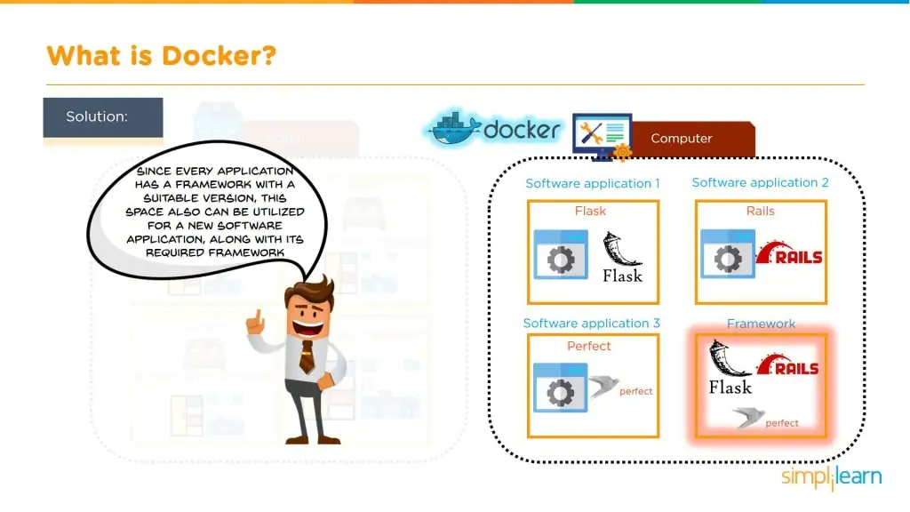

Slide 36
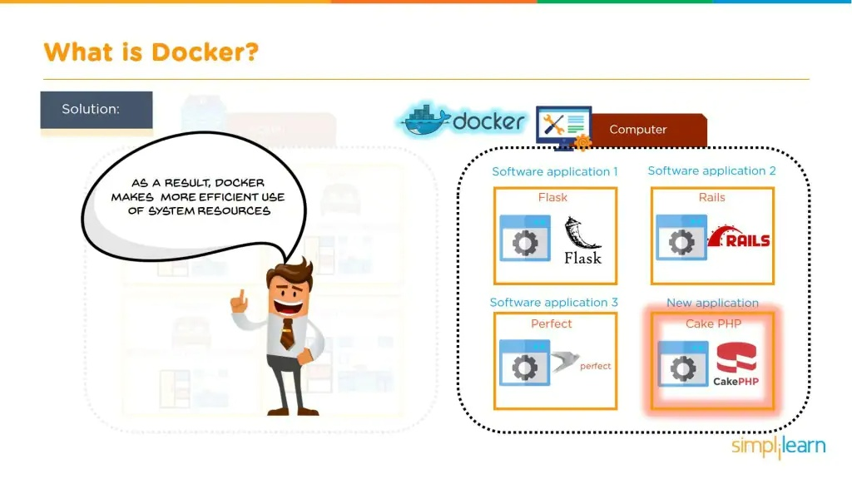

Slide 37
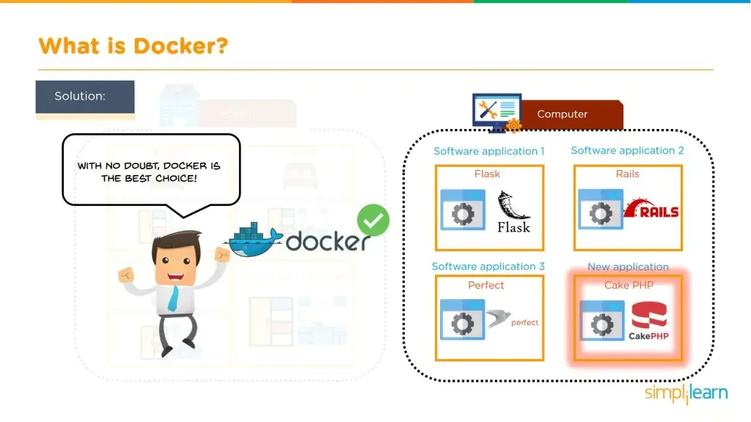

Slide 38
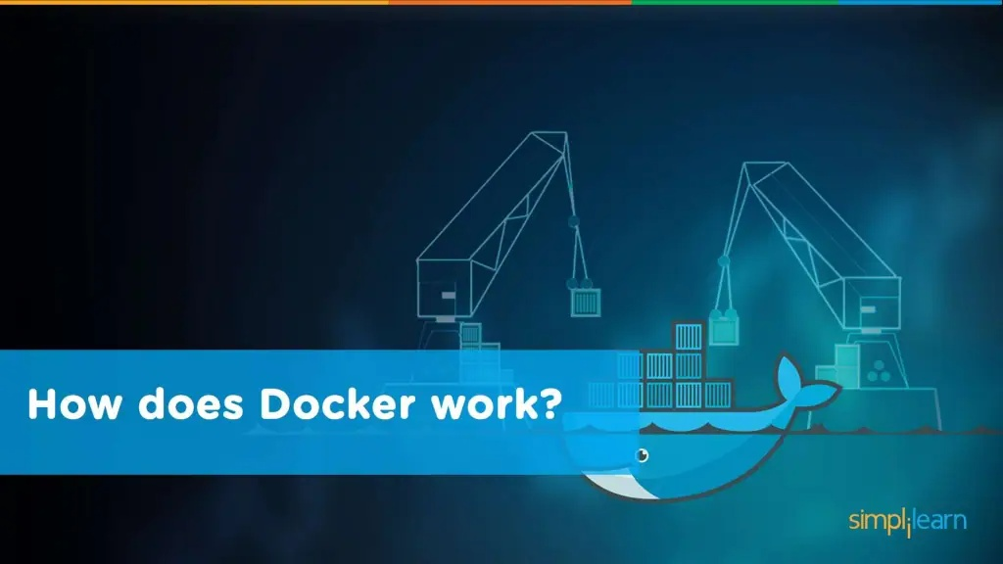

Slide 39
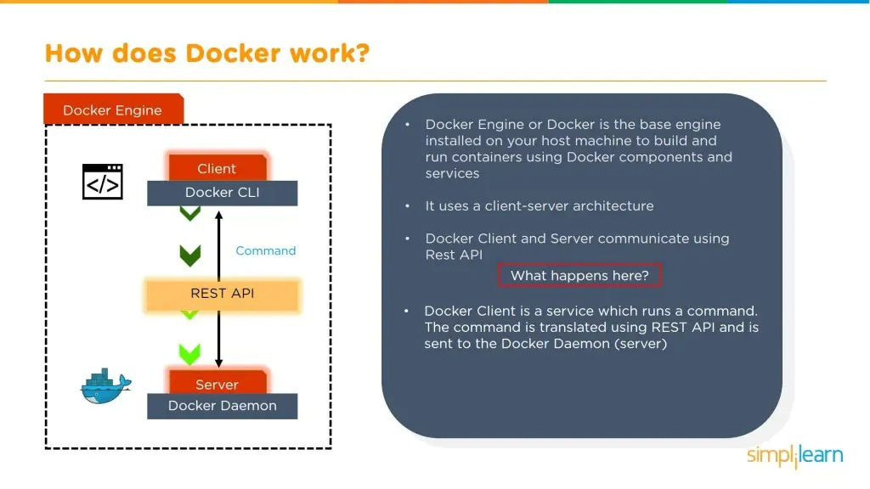

Slide 40
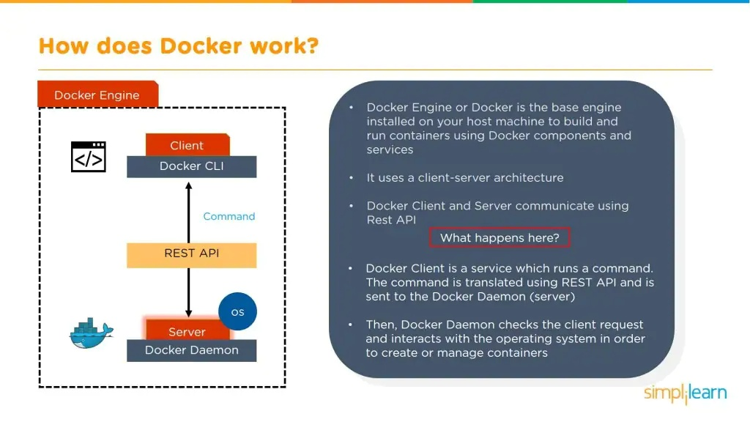

Slide 41
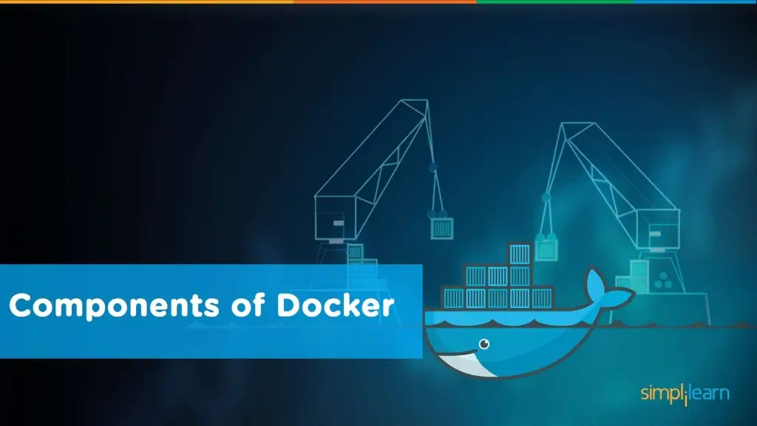

Slide 42
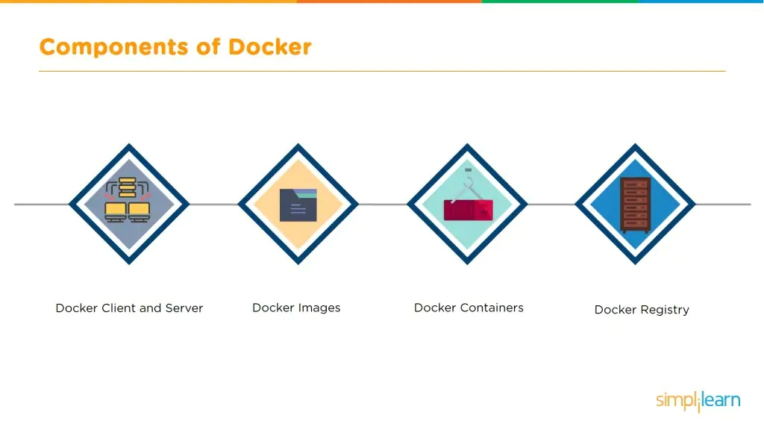

Slide 43
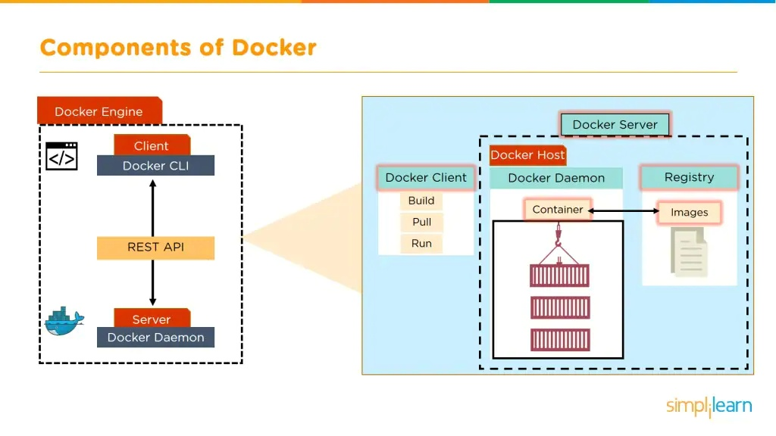

Slide 44
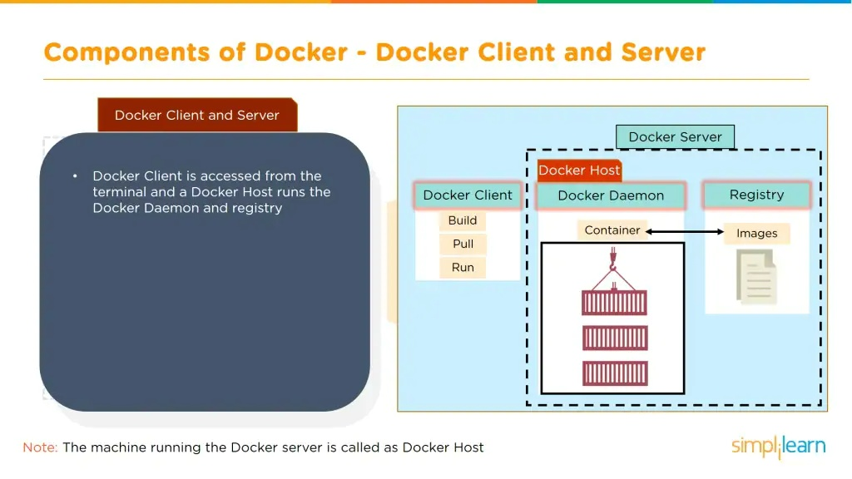

Slide 45
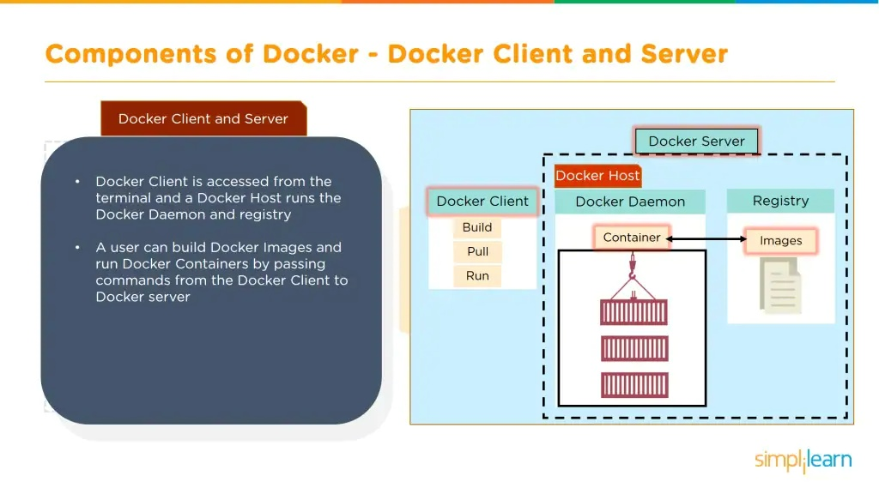

Slide 46


Slide 47
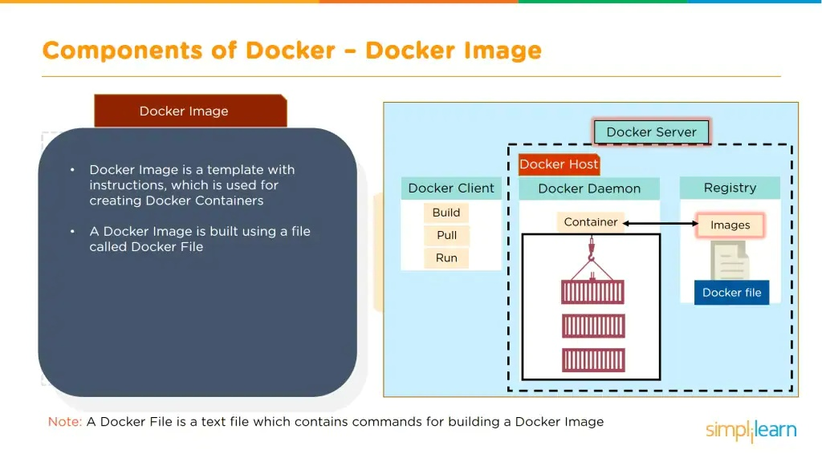

Slide 48
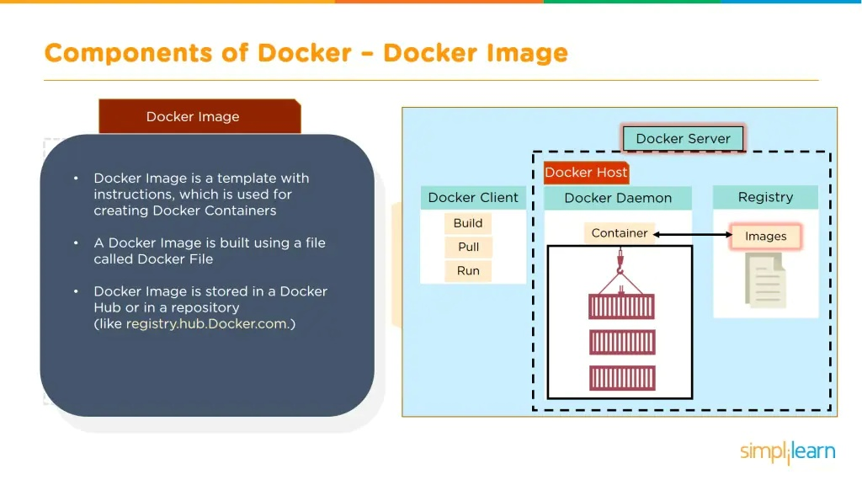

Slide 49
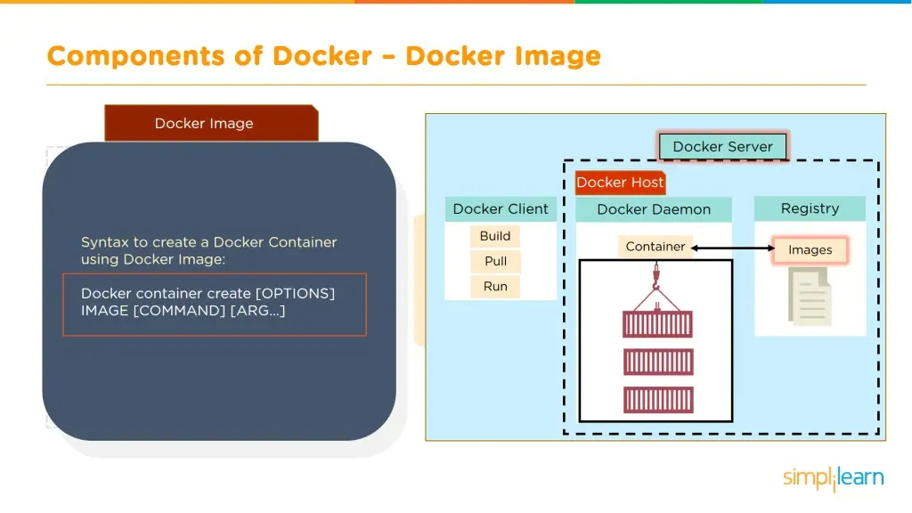

Slide 50
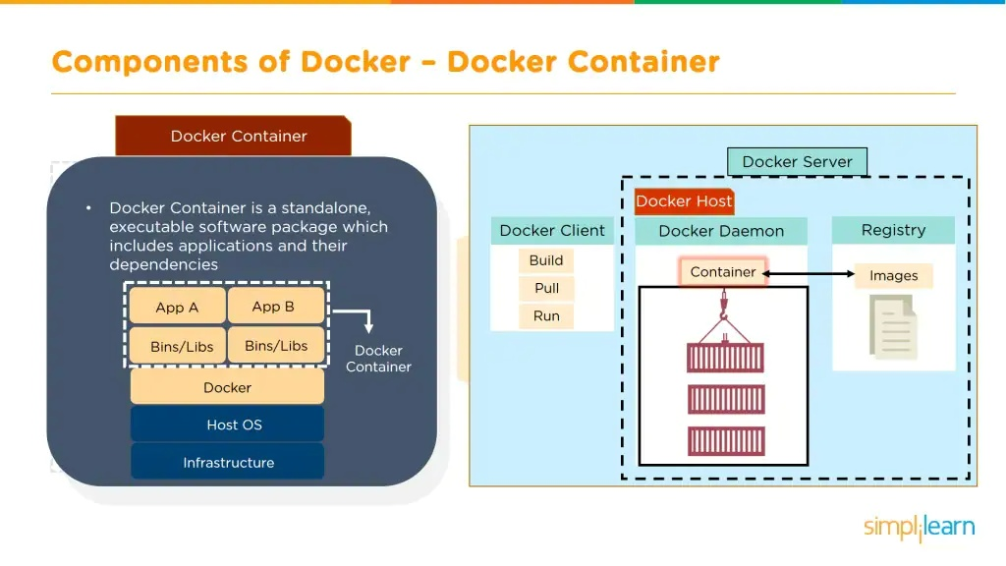

Slide 51


Slide 52


Slide 53


Slide 54


Slide 55


Slide 56


Slide 57


Slide 58


Slide 59


Slide 60


Slide 61


Slide 62


Slide 63


Slide 64

Installing Dockers

Slide 65

Development workflow

Slide 66


Slide 67


Slide 68


Slide 69


Slide 70

Deploying an app using containers

Slide 71

node app.js

Slide 72

Dockerfile
Each Dockerfile is a script, composed of various commands (instructions) and arguments listed successively to automatically perform actions on a base image in order to create (or form) a new one. They are used for organizing things and greatly help with deployments by simplifying the process start-to-finish.
Dockerfiles begin with defining an image FROM which the build process starts. Followed by various other methods, commands and arguments (or conditions), in return, provide a new image which is to be used for creating docker containers.
They can be used by providing a Dockerfile’s content - in various ways - to the docker daemon to build an image (as explained in the How To Use section).

Slide 73
Dockerfile Commands
ADD
CMD
ENTRYPOINT
ENV
EXPOSE
FROM
MAINTAINER
RUN
USER
VOLUME
WORKDIR

Slide 74
To tell docker to package our application:
sudo docker build -t <Dockerhub repo name>:<tag name> .
To check the existing docker images:
docker image ls
To run the docker images:
docker run [<image-name>:<tag name>] / [<ID>].
List all docker containers : docker ps -a

Slide 75
To push images to Dockerhub
Login to the docker.
docker login -u <user-name> -p <password>
sudo docker push dj-docker:latest (If you get an error then step:2)
2) Tag your image build
my image name here is : dj-docker and by default it has tag : latest
my username is : djddocker17 as registered with docker cloud, and I created a public repository named : djtest
so my personal repository becomes now : djddocker17/djtest and I want to push my image with tag : dj-docker
Tag change: sudo docker tag dj-docker:latest djddocker17/djtest:nodeapp
3) Pushed the image to my personal docker repository as below
sudo docker push djddocker17/djtest:nodeapp
4) To logout of docker use: docker logout

Slide 76
Run the app in another environment
https://labs.play-with-docker.com/ (Docker play)
Type node to check if environment is available
Check version
docker pull djddocker17/djtest:nodeapp
docker image ls
docker run djddocker17/djtest:nodeapp

Slide 77



Remove Docker Containers and images:
Remove Docker images:docker rmi

Slide 78
Maven Java App
FROM centos:latest
RUN yum install java -y
RUN mkdir -p /opt/tomcat
WORKDIR /opt/tomcat
ADD https://dlcdn.apache.org/tomcat/tomcat-9/v9.0.55/bin/apache-tomcat-9.0.55.tar.gz .
RUN tar -xvzf apache-tomcat-9.0.55.tar.gz
RUN mv apache-tomcat-9.0.55/* /opt/tomcat
EXPOSE 8080
COPY MyMavenApp.war /opt/tomcat/webapps
CMD ["/opt/tomcat/bin/catalina.sh", "run"]
docker run -d --name <containername> -p 8001:8080 <imagename>

Slide 79
Docker volumes
Scenario - Th
Sudo docker exec -it <container Id/name> bash
Create Dir inside docker container – mkdir /app
Create files inside the docker container – touch hello.txt hello1.txt
Write some contents into the container –
Stop the container (eg say accidentally someone stops it)
Then the data you have created will be lost. Hence to retain data inside the containers we need to used volumes
Two options to overcome this
Option 1: in the host system create a folder (mkdir app)
Go to the folder and recreate the same scenario create files and put some data in the files.
Now we can share the data between the host and containers.

Slide 80
Sudo docker run –it –d –v <path of the folder to share> <app folder in the host machine>:<path folder in the container> <docker image>
Sudo docker run –it –d –v app:/app ubuntu
Sudo docker exec -it <container Id/name> bash
We will find rhe same data that was there inside the host systems folder in the container also.
Now try the same scenario to see if the data persists even after the container stops and we create multiple containers.
PROBLEM WITH THIS OPTION IS THAT THIS SAME THING CANNOT BE DONE IN WINDOWS AS FILE SYSYTEM DIFFERS.
PROBLEM 2 IS THAT THIS CANNOT BE SHARED
We use docker volumes to overcome this problem.

Slide 81
First we create a volume – sudo docker volume create <name>
To check if the volume is created – sudo docker volume ls
To check how it looks – sudo docker inspect volume <nameofvolume>
Now we can share this volume with different containers
Sudo docker run –it –d --mount src=(volumename),dst=(destination in the container) <image name>
Eg sudo docker run –it –d --mount src=mydata,dst=/mdata ubuntu
Then you can enter the container and check if the volume is available
Sudo docker exec –it <container name/id> bash
Then add some data from the container. Then go to a another container sharing the same volume and check if the data is shared across different containers sharing the same volume.

Slide 82
Docker compose
Lets say there is webapp which has 3 tier architexcture. Then keeping everything inside a single container is not a good idead. So its better to have database in aseperate container. So if something goes wrong with application llayer database remains intact as it is running In another comntainer.
Docker compose is a file that starts multiple containers together and ties them together.
Start with the wordpress example – moodle server
First install docker compose
Create a folder in host. Cd to the folder. Save the docker-compose.yml file.
Sudo docker-compose (it will build the containers from the docker compose file) up (build the image and run the container) –d (run the background)
Open browser go to hostIp install wordpress done

